Slide 1
Radiance Technologies
310 BOB HEATH • HUNTSVILLE, AL 35806 • 256-704-3400 • www.radiancetech.com
RADIANCE TECHNOLOGIES, INC. PROPRIETARY INFORMATION:
The information contained herein may not be used in whole or in part except for the limited purpose for which it was furnished. Do not distribute, duplicate, or reproduce in whole or in part without the prior written consent of an authorized official of Radiance. Exempt from disclosure to third parties under 5 USC 552(b)(4). 18 USC 1905 may apply.
Concepts to Capabilities

Slide 2
Who We Are
We are 100% employee-owned, which means that every employee at Radiance has a stake in the company. We take ownership of our work because we know that the future of Radiance hinges on what we do today.
We serve each other by creating an environment of growth and prosperity where we can enjoy our personal and professional lives. We hold each other accountable through our core values and business practices. We encourage each other to grow and master our professions, not just for the bottom line, but for the success of each and every one of us.
While we can’t be all things to all people, we do try to provide each and every employee-owner with challenging work, an outstanding culture, excellent benefits, and a balanced work life. It is our goal to create a company where you can feel fulfilled with what you do and be proud to say, “I work at Radiance Technologies.”

Slide 3
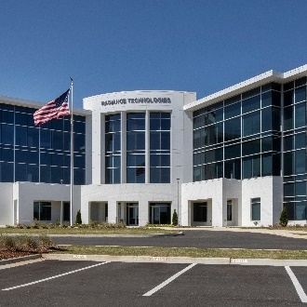
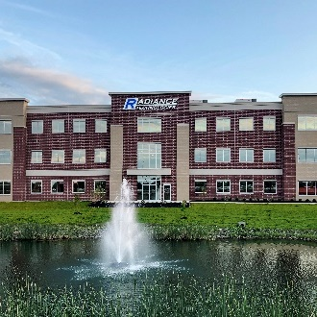
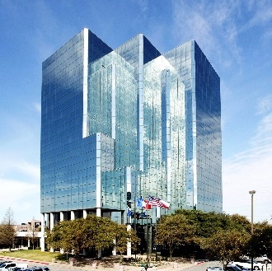
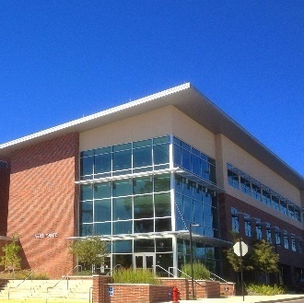
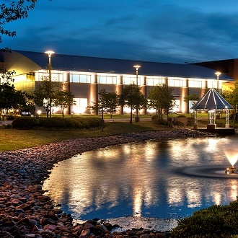
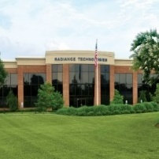
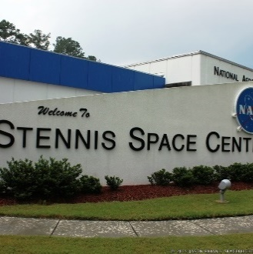
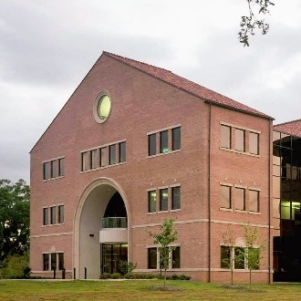
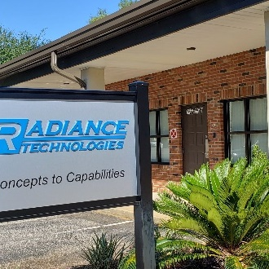
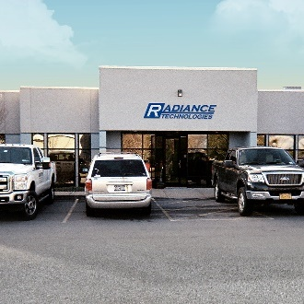
Where We Work
Radiance Technologies has 11 offices and 22 project offices located in 20 states. Our footprint spans coast to coast. We have offices located within a few miles of several military bases and space and aeronautic centers. We bring together people with remarkable technical abilities and a deep understanding of our customers’ missions.
Huntsville, AL
Dayton, OH
San Antonio, TX
Ruston, LA
Shreveport, LA
Stennis, MS
Baton Rouge, LA
Shalimar, FL
Rome, NY
NCR-Crystal City, VA
= Headquarters

Slide 4
What We Do
INTELLIGENCE
CYBER
PROTOTYPING
DIRECTED ENERGY
TEST & TRAINING
SPACE
Weapon System Exploitation
Intelligence Analysis
Exploitation & Production
Artificial Intelligence / Machine Learning
Modeling & Simulation
Analytical Tool Development
Web Migration / Cloud Development
Software Reverse Engineering
Vulnerability Research, Assessment, and Analysis
5G Security & Exploitation
Cyber Security of AF Weapon Platforms
Critical Infrastructure Cyber-Physical Security
Automated Device & System Exploitation Tool Development
Hardware Design
Mechanical Design
Electronics and Electrical Design
Software Development
Traditional & Agile Development
DevSecOps
Cybersecurity Hardening
Qualification
Substantiating Analyses
Environmental/Dynamic/E3 Testing
M&S
Product Realization & System Integration
Fab Shop/Labs
High-Bay Facilities for
Assembly, Integration & Checkout
AS9100 Certified
HEL Systems
Design/ Analysis/ Integration
Lethality Analysis & Testing
Modeling, Simulation, and Analysis
Test and Evaluation
HPM Systems
Effects, Lethality, & Vulnerability Analyses
Source Development
Power Technologies
Microelectronics effects studies
RF Material Interaction studies
Comprehensive Test & Evaluation Support
Range Infrastructure Upgrades
Software Development and Implementation
HWIL/SIL Development/ Facilities
Immersive Trainer Systems
Procedural
Mission Rehearsal
Crew Member Coordination
Trainer Systems Development
Digital Engineering
System Integration
Remote/On-site Technical Support
Physics-based Modeling, Simulation, and Analysis
SDA and SSA
Model-based Systems Engineering (MBSE)
Software Design, Development, and Testing
Space Control Training & Operations Support
Subsystem Development and Integration
Developmental Test and Evaluation
Positioning, Navigation and Timing (PNT)

